Slide 1
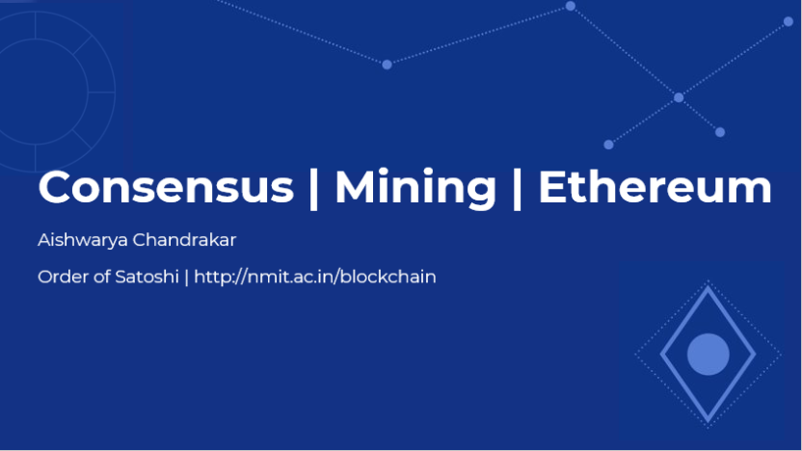

Slide 2
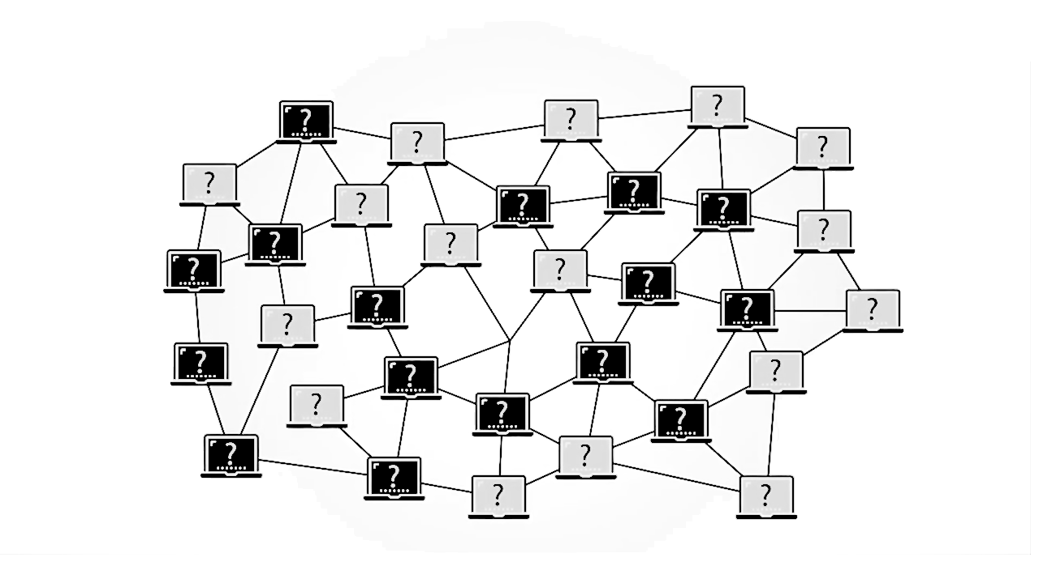
BLOCKCHAIN

Slide 3

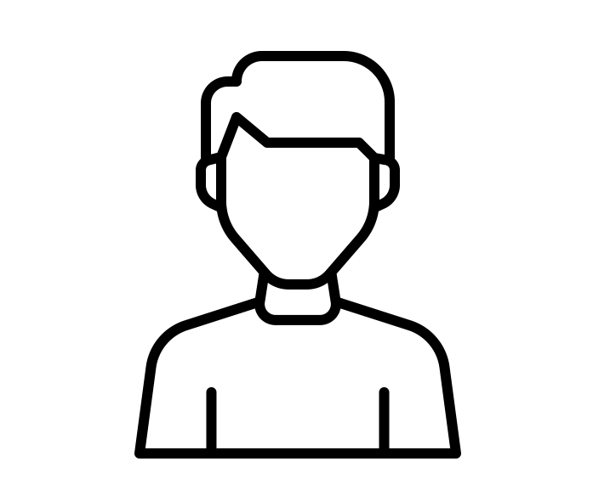

Address:
14M1HCMJSxmAndskdjgsu8273KSsj81
Address:
13dP72HD9288hdjsnsj63jHG227bxk72
Amy
Jim

Slide 4


Address:
14M1HCMJSxmAndskdjgsu8273KSsj81
Address:
13dP72HD9288hdjsnsj63jHG227bxk72
Amy
Jim
(Recipient)

Slide 5

Address:
14M1HCMJSxmAndskdjgsu8273KSsj81
Address:
13dP72HD9288hdjsnsj63jHG227bxk72
Amy
Jim
(Recipient)

Slide 6

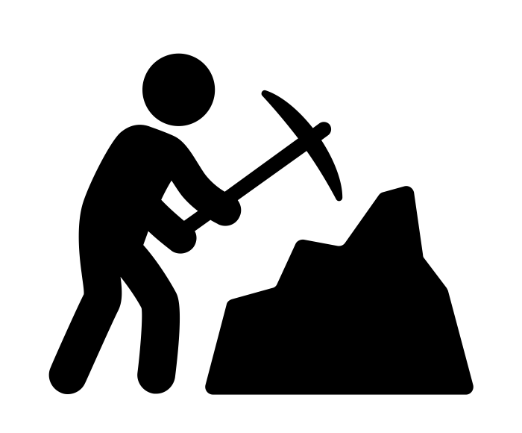

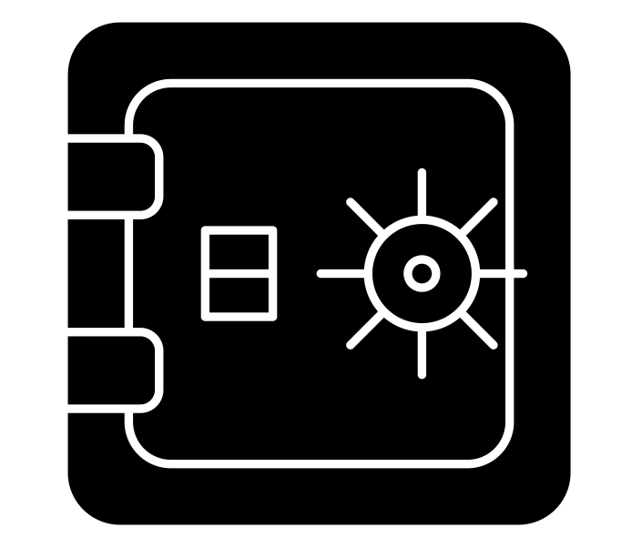

CONSENSUS MECHANISMS
Proof of Stake
Proof of Work
Proof of Authority

Slide 7
Proof of Work

Slide 8



PROOF OF WORK
Guesses Number
Receives Reward

Slide 9
Proof of Stake

Slide 10






The higher the Stake placed,
the higher the chance to be selected
$
VALIDATOR
$
$
$

Slide 11
Proof of Authority

Slide 12



Validators are selected based
on Reputation

Slide 13
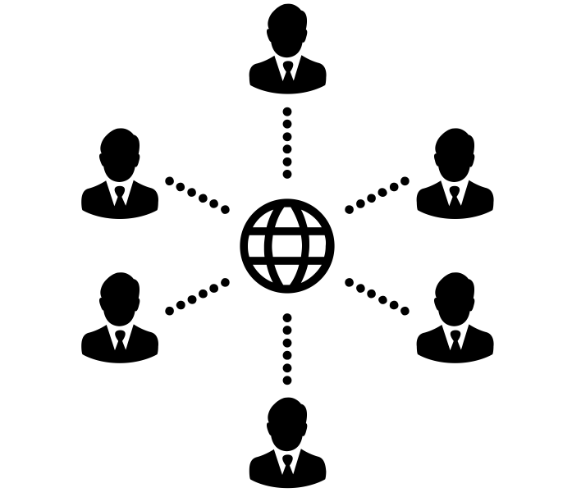
BLOCKCHAIN TECHNOLOGY
Cryptography
+
Proof of Work
+
Decentralized
networks

Slide 14
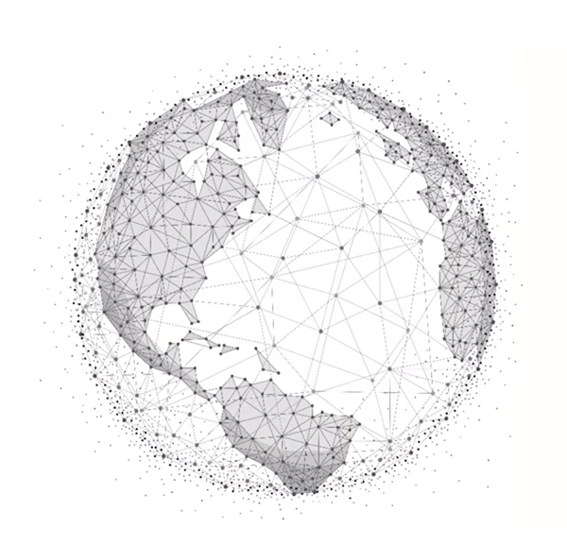
THE BITCOIN NETWORK
Turing Incomplete

Slide 15


Bitcoin
Ethereum

Slide 16
THE ETHEREUM NETWORK
DIY Platform for Dapps

Slide 17
SMART CONTRACTS
Self-Executing
Letter Strict
Immutable
Difficult to Secure

Slide 18
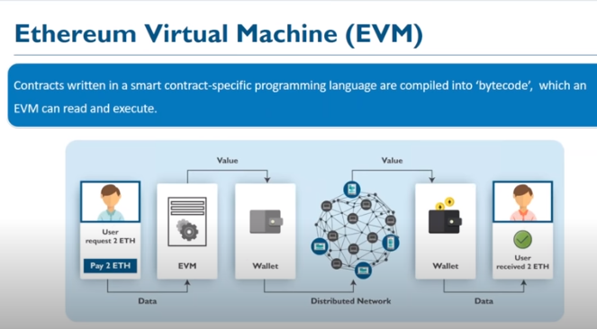

Slide 19
THANK YOU.

